Slide 1
Agenda
Design & Implementation of OS

Slide 2
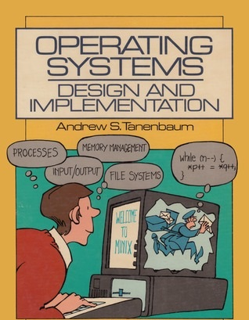
While design of any operating system many factors need to be considered, from both user and system prospective.
The design and Implementation must be careful because if design fails so it may leads to produce bad/wrong O/P and will become reason to unsatisfied the user

Slide 3
Fundamental Principles
Performance: For any product that must have perfect and should able to perform task with good manner and this is also big issues while OS designing.[average bytes per read/write, average read/write time, disk reads/writes per second, network utilization, pages input per second, pages per second, processor queue length, and processor usage.]
Robustness: While any hazards in system, OS should be robust because if it collapses it cannot produce desired output and user could not get any satisfaction. Also system should be hard to break.
Efficiency: OS should be efficient to produce the O/P.
Scalability: OS should have scalability capability, if any user wants to increase the number of operations that time OS should support to user requirement up to some extents.[so throughput can increase]
Predictability: It should not be unpredictable. Every time it should produce the same result.
Exclusive use of Resource: It’s should provide fair and exclusive use of resource to each process. So that they can executes their task without interleaving to other process.
Modularity:- So it will easy to debug and test
Reliable: So user can trust and Simplicity and many more

Slide 4
Consideration for Design and Implementation of OS
Design Goal
Mechanism and policy
Implementation
System structure

Slide 5
Thank You
We will meet Soon!!!!!!!!!!

Slide 6
Agenda
Design & Implementation of OS

Slide 7
Consideration for Design and Implementation of OS
Design Goal
Mechanism and policy
Implementation
System structure

Slide 8
Design Goal
The primary goal of some of operating system is satisfied the user, efficient operation of the computer system.
Design Goal of OS is categorized into two types.
User Goal: As a user perspective OS should be:-
Easy to used,
Must be reliable,
Convenient
Safe, fast to produce any output,
Easy to learn and may more as all user requirements.
System Goal: As a system perspective it also having same goal while design.
It should be Error free.
Easy to design, reliable, flexible.
It should have fair maintenance.
It should effective to produce results

Slide 9
Mechanism and policy
Mechanism - Mechanism determine “how to do”??? .
Mechanism is simply, if we want to protect some resources then how that resource can be protected.
E.g. In order to protect CPU we uses timer mechanism.
Consider a mechanism for giving priority to certain type of programs over other.
If mechanism is properly separated from policy, it can be used to support policy decision.
Mechanism achieves the fair and protected use of CPU among the processes.
Policy – Policies are also one of the most important principles of OS design.
The policy may vary place to place, system to system and time to time.
Decision is important for all resource allocation reallocation and scheduling.
E.g. how many times user will allow to uses a resource.
In simple word policy is nothing but "what to do"?
For example –
If the mechanism and policy are independent, then few changes are required in mechanism if policy changes.
If a policy favours I/O intensive processes over CPU intensive processes, then a policy change to preference of CPU intensive processes will not change the mechanism.

Slide 10
Implementation
Once design and other criteria are set we need to think how to develop an OS which will be able to work properly.
The implementation is a part of development of new OS by using the language paradigm.
With the help of any language construct we can develop the OS.
In earlier era the OS were developed in assembly level language but assembly level language has so many drawbacks.
But now a day’s C/C++ (oriented language) are the language that are commonly used.
Still small blocks of assembly code are needed for development
Advantages of High level language
Now a day the high level language is used to build an OS (kernel).
Especially C language is preferred to design of OS.
High level language is easy to code, easy to understand.
More compact to maintain.
Easy to debug and easy to port.
Higher level languages allow the code to be written faster. It also makes the OS much easier to port to different hardware platforms
Drawback of Assembly Language
Assembly language is difficult to code.
It needs to keep extra information in consideration, like op-code etc.
Assembly level language does not support to modularity.
It also not has convenient to user, as it is hard to code.
After the system is coded it needs to be configured to work on a specific machine.
The type of CPU
Available memory
Available I/O devices etc.

Slide 11
System structure
Design and implementation system structure is categorized into some parts.
This design issues show how system looks like internal working.
How different services can be developed to different level.
There are some structures of OS for design purpose.
Simple structure
Layered approach
Microkernel
Monolithic kernel

Slide 12
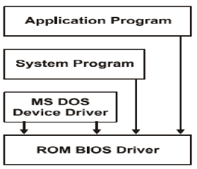
Simple structure
Traditional OS, like MS-DOS/old UNIX are have simple structure.
The hardware protection dual mode is not present in simple structure.
All block are treat as the simple i.e. either user or system mode. (Means there are no provision to switch the mode).
The structure of OS is not separated and all services are provided in bulk of module.
Even it is not possible to modify the structure to the user (constant structure, figure).
Due to a single system structure all function are dependent on each others.
If one fail so it affects others and they may lead to total crash.
It is quite dependable on each other ultimately it take time to load and has low performance.

Slide 13
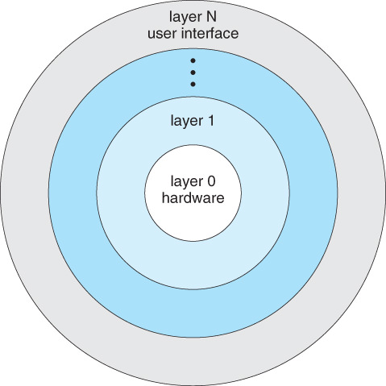
Layered Approach
In order to overcome the drawback and provide separate functions at each level the layered approach was invented.
In that the different layers are design to provide separate services.
Very 1st layer (bottom layer 0) is an H/W layered which supports to H/W activity and their driver routines.
Layered 1is dedicated to process management Layered 2is allocated to memory-management Layered 3manages I/O device and buffering the information Layered n etc.
( figure shows idea), The fact is that, every layer provides services to each above it.
At last upper layer is user interface layer that provides user interface to user for suitable use of OS, for every function.
Advantages:-
Due to separation of layer and services it leads to modularity concepts.
It allows developer to change inner working of any layer.
It supports design of OS (because user get change to design develops some new things).
Disadvantages:-
It is user oriented so the changes made by users, could not understand by others and also it’s not required to others.
Need careful definition of each layer at time of implementation.

Slide 14
Thank You
We will meet Soon!!!!!!!!!!

